Slide 1



TECHCROP
IAM
Information available in audio.

Slide 2


Agenda
Implementation Plan
Integration Challenges
Visual Aids
Alignment with business goals

Slide 3
Implementation Plan
Planning & Assessment
Conduct stakeholder analysis
Inventory of existing systems and apps
Define IAM scope, goals, and compliance requirements
Timeline: Week 1–2
Resources: IAM Architect, Security Analyst, Project Manager

Slide 4







Goal # 1
Select IAM tools (e.g., Okta, SailPoint, Azure AD)
Design & Architecture
Goal # 2
Define Role-Based Access Controls (RBAC)
Timeline: Week 3–4
Deliverables: System architecture, integration plan.
Goal # 3
Plan integration with HRMS, directories, cloud platforms

Slide 5
Goal # 1
Configure provisioning workflows (Joiner-Mover-Leaver)
Development & Configuration
Goal # 2
Set up MFA, SSO, PAM
Timeline: Week 5–7
Resources: DevOps, IAM Engineers
Goal # 3
Develop policies for privileged accounts

Slide 6
Goal # 1
Conduct unit and integration testing
Testing & Deployment
Goal # 2
Perform UAT with business teams
Timeline: Week 8–9
Deliverables: Test reports, release documentation
Goal # 3
Deploy in phases with rollback plan

Slide 7
Goal # 1
Train helpdesk and IT teams
Training & Support
Goal # 2
Timeline: Week 10
Resources: Trainers, Communications, Support Staff
Onboard employees to the new IAM interface
Goal # 3
Establish support protocols and documentation

Slide 8

Legacy system compatibility
Integration Challenges
Potential Obstacles
Vendor lock-in or third-party tool conflicts
Cloud sync latency
Mitigation Approach:
Use open standards (SAML, OAuth, SCIM)
Run pilots before full rollout
Continuous monitoring via SIEM tools

Slide 9

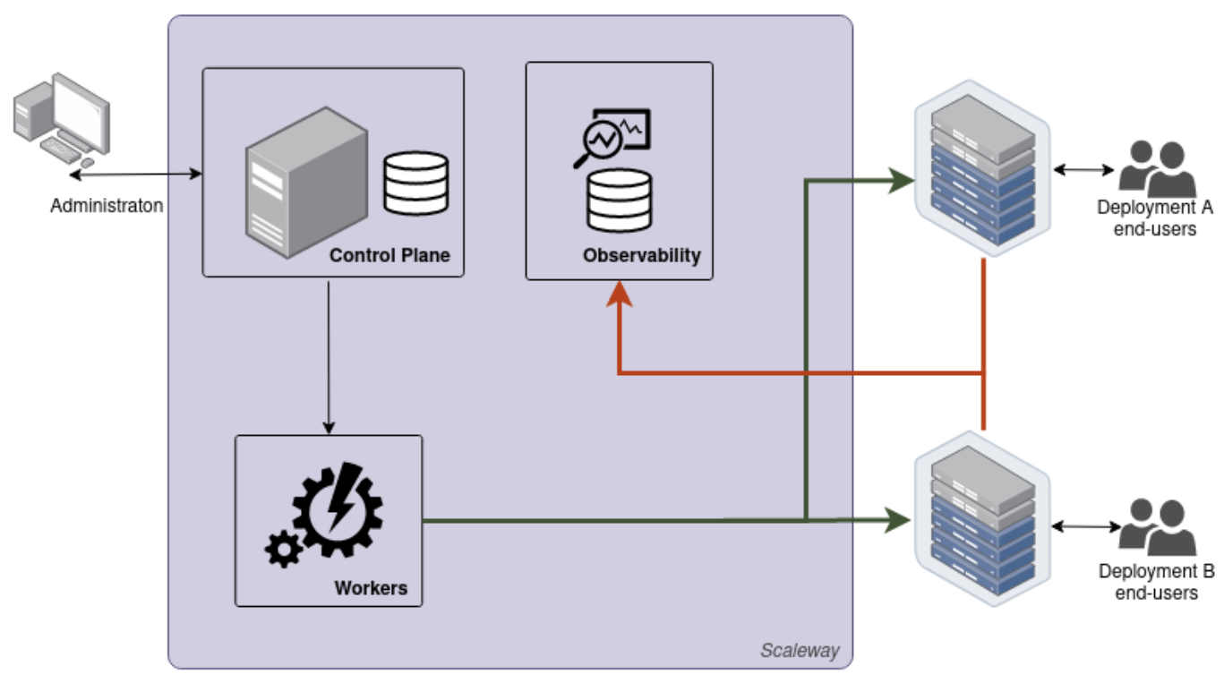
Visual Aids

Slide 10
Supports TechCorp’s digital transformation
Improves user satisfaction through SSO & automation
Alignment with Business Goals
Reduces cyber risk & insider threats
Ensures regulatory compliance (e.g., GDPR, HIPAA)

